Slide 1
Graphical Analysis

Slide 2
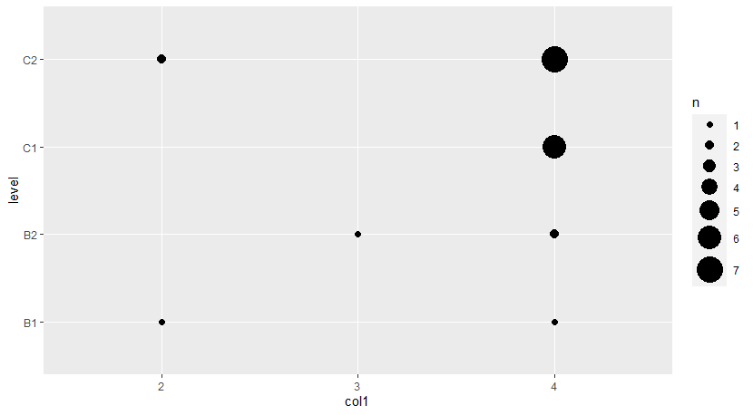
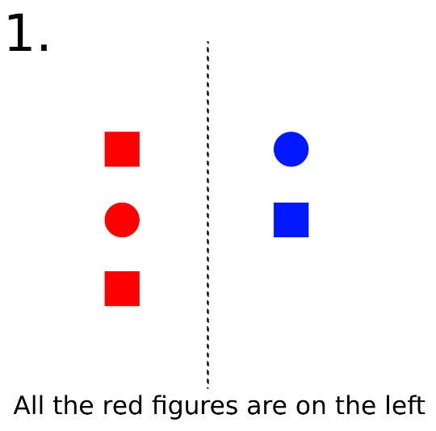
Question 1-1

Slide 3
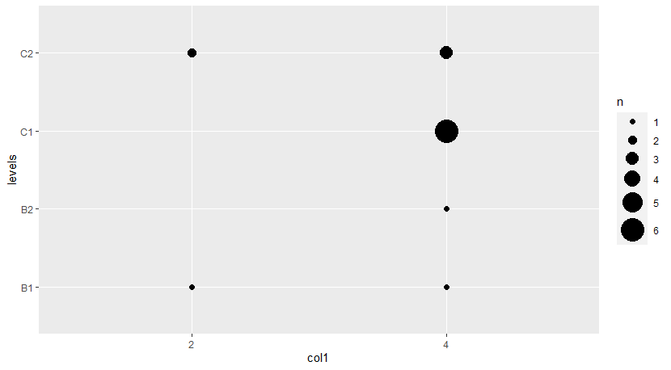
Removing failed control:

Slide 4
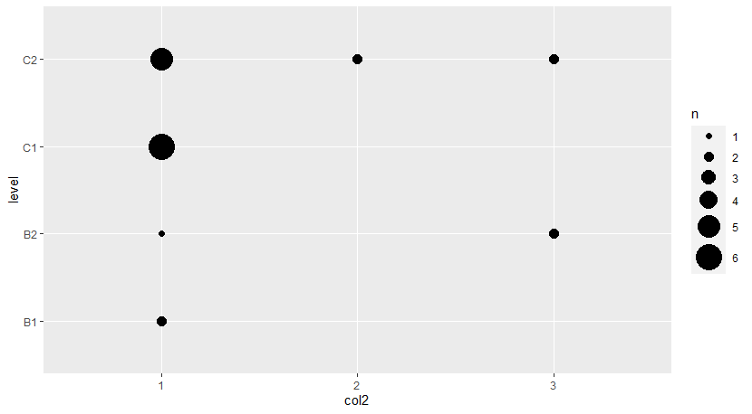
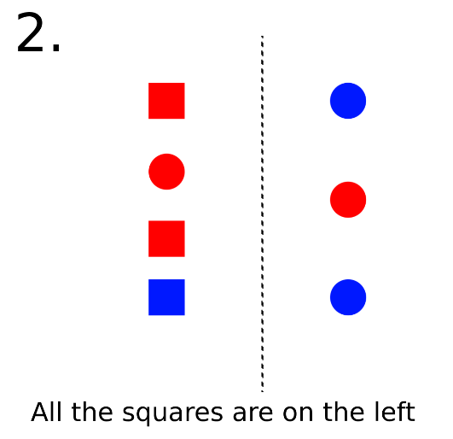
Question 1-2 (control)

Slide 5
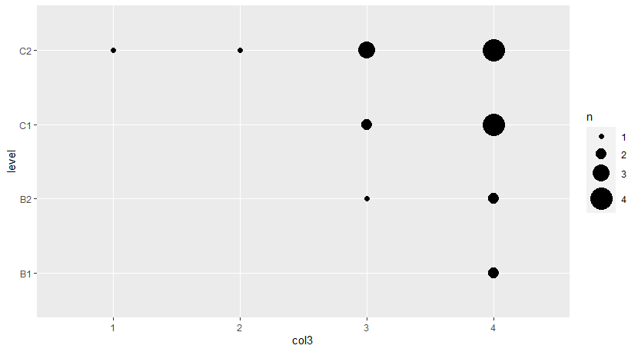
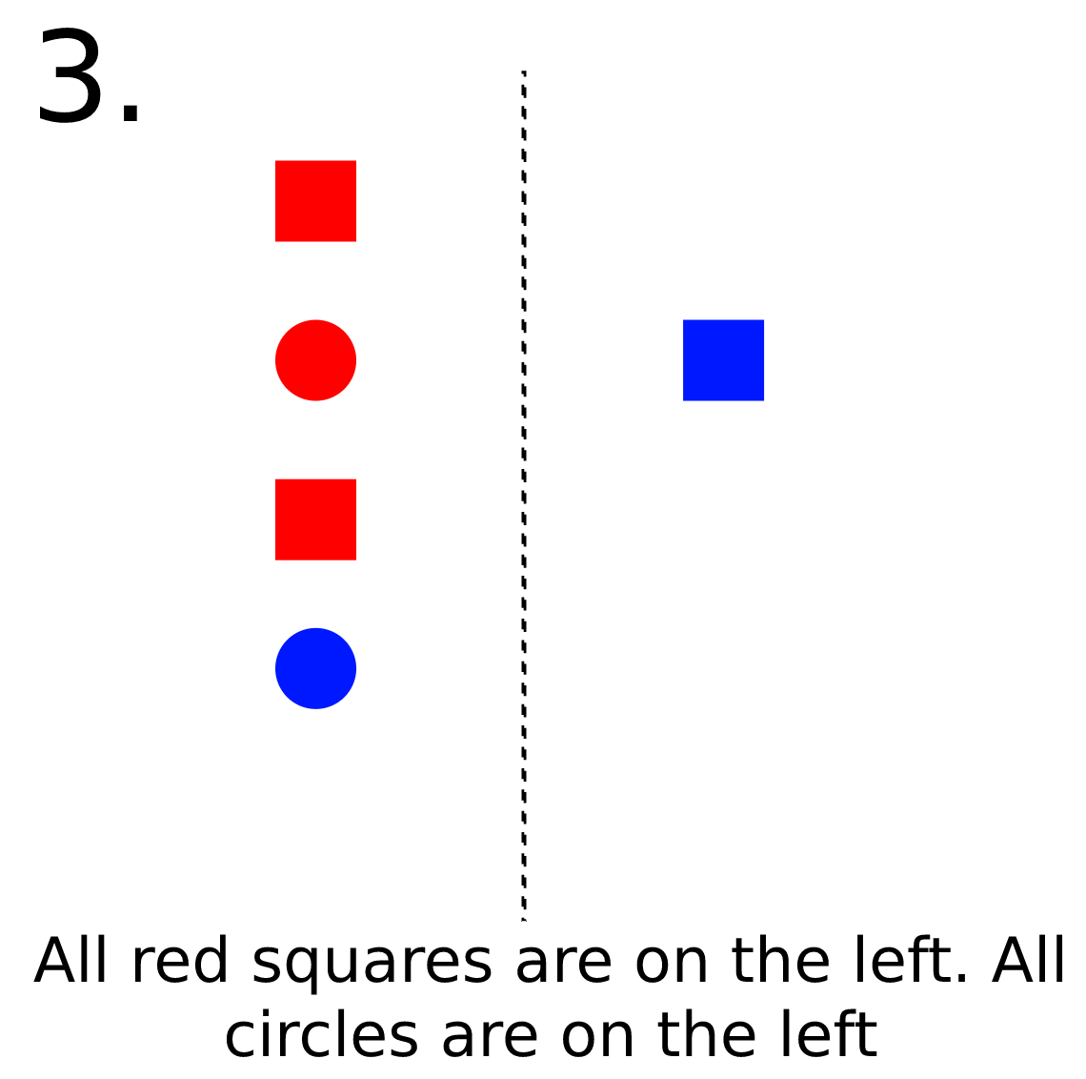
Question 1-3

Slide 6
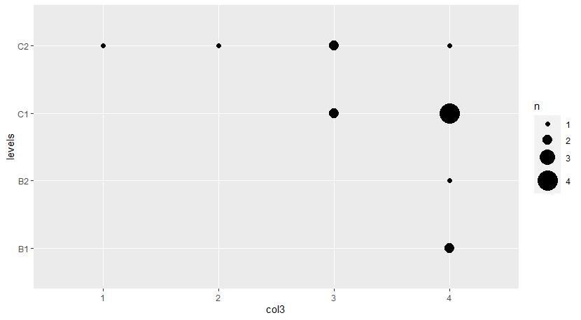

Slide 7
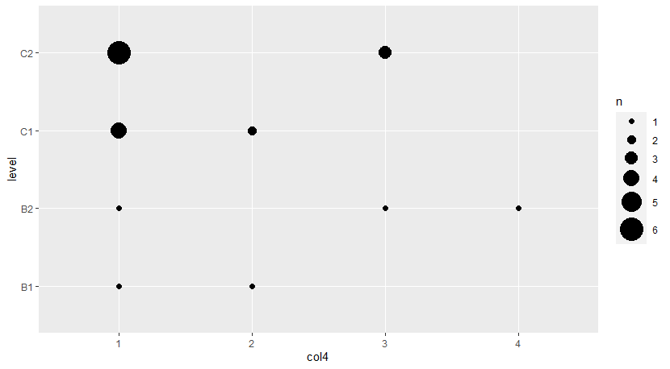
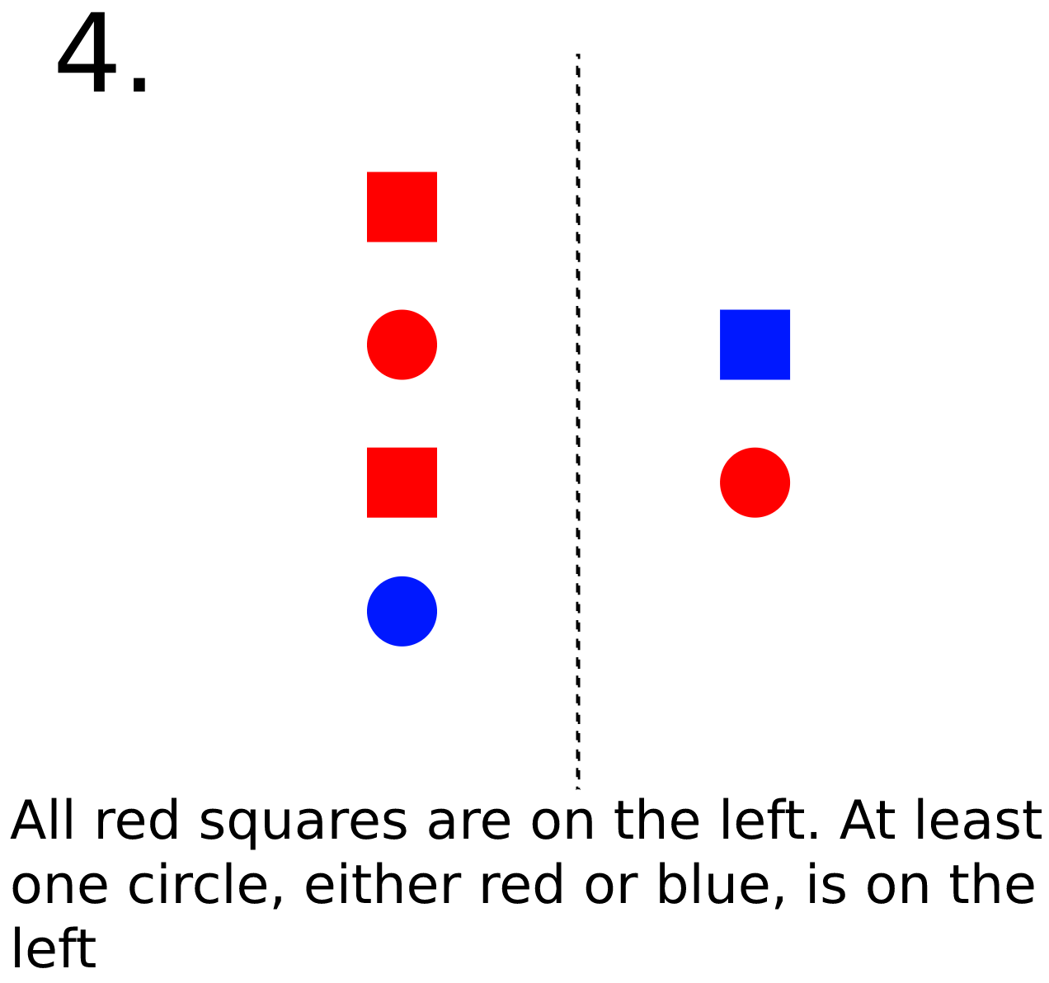
Question 1-4

Slide 8
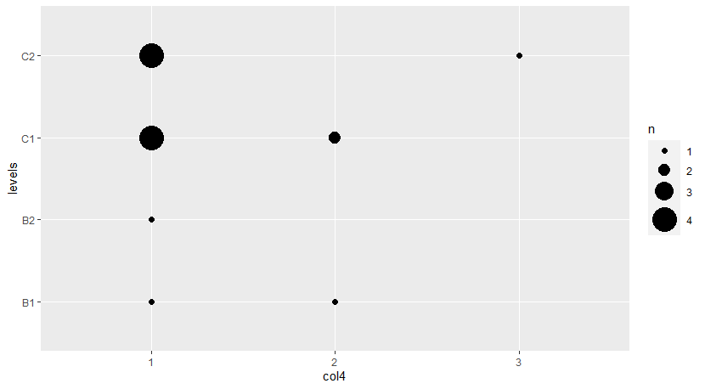

Slide 9
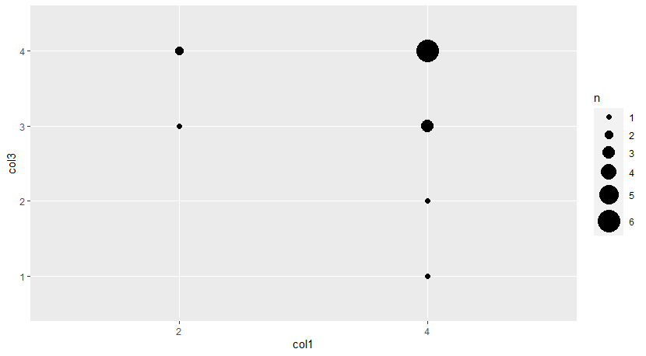
Comparison between 1 and 3:

Slide 10
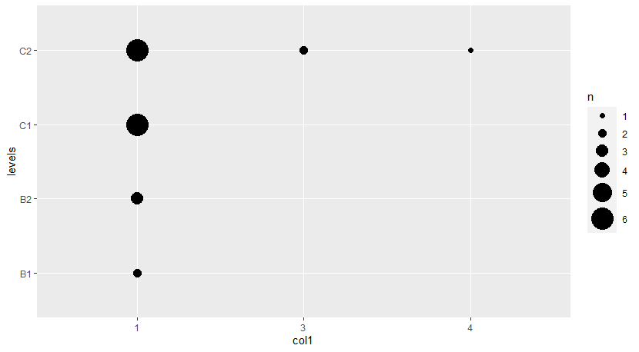
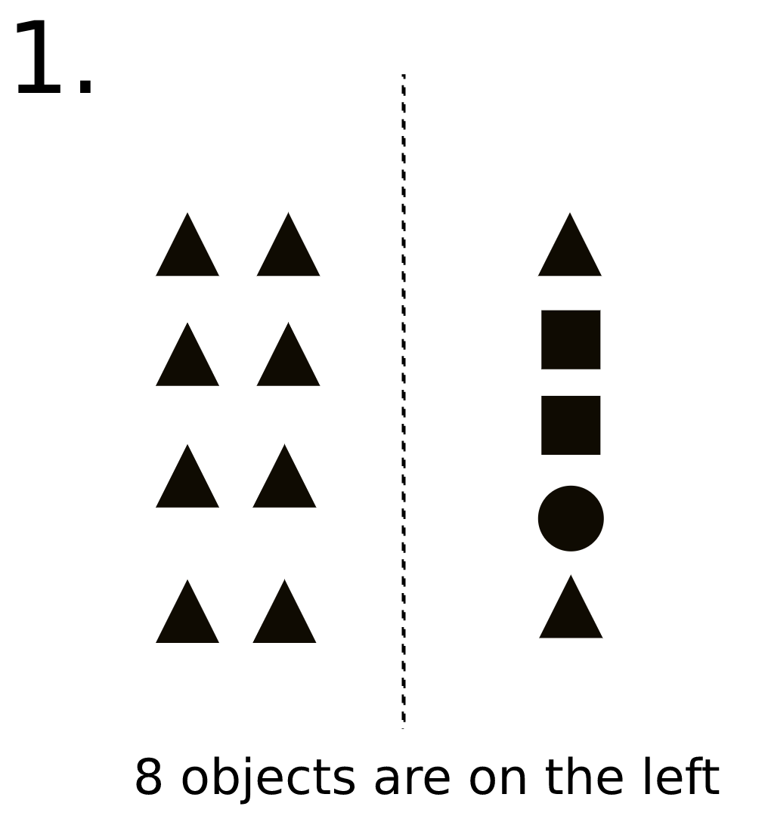
Question 2-1 (control)

Slide 11
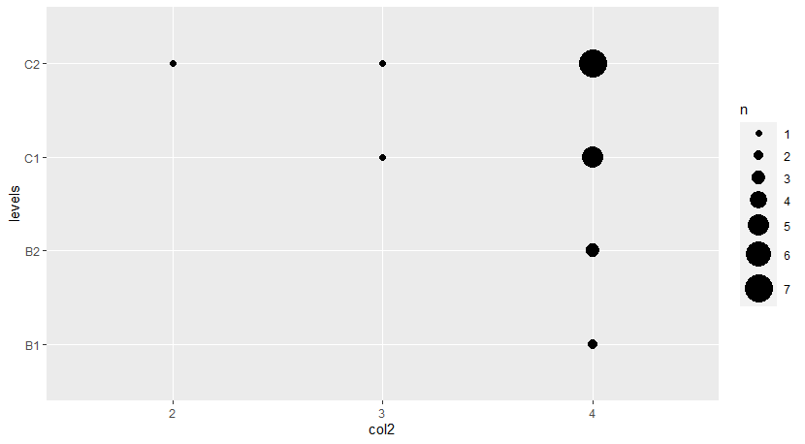
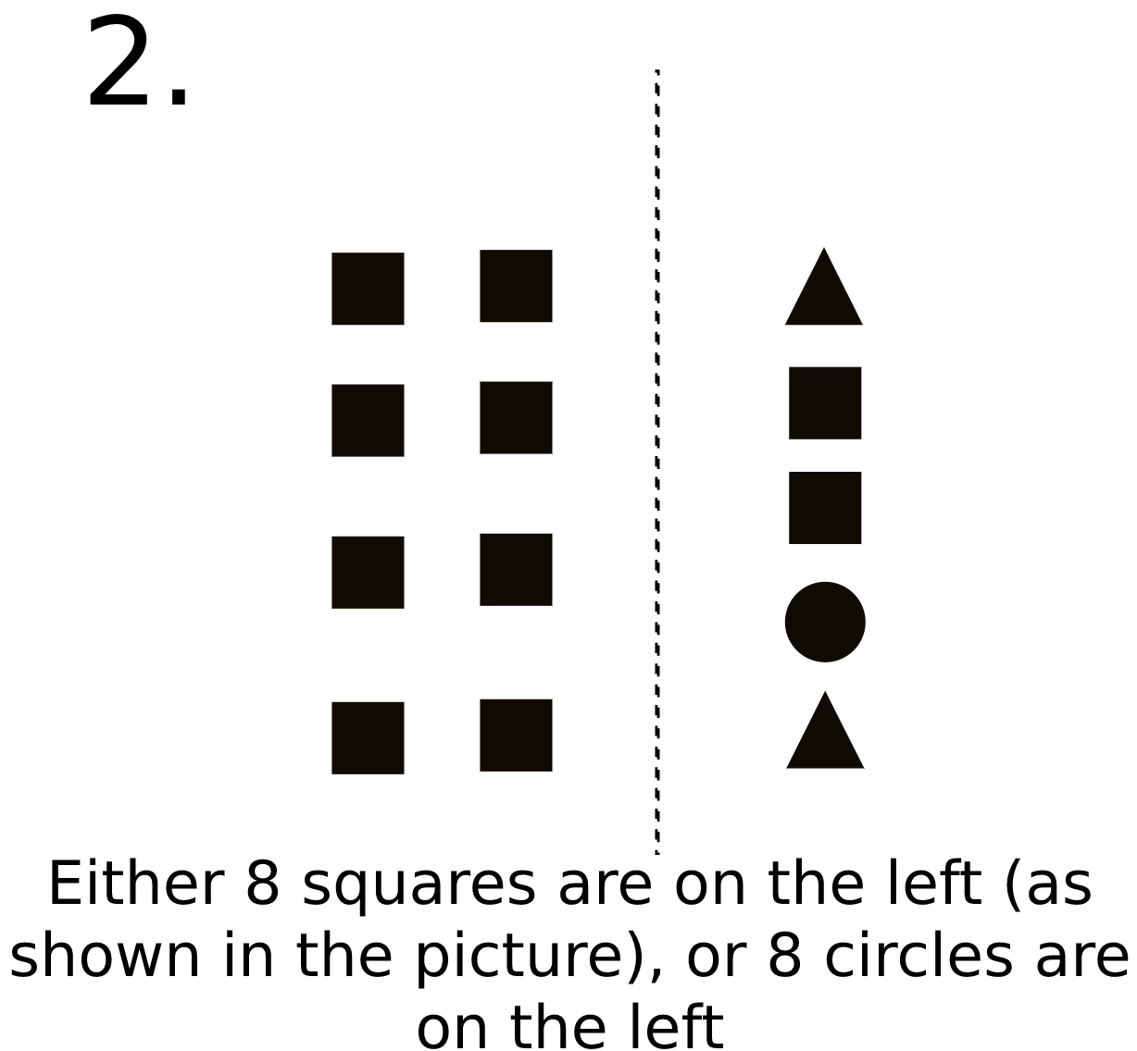
Question 2-2

Slide 12
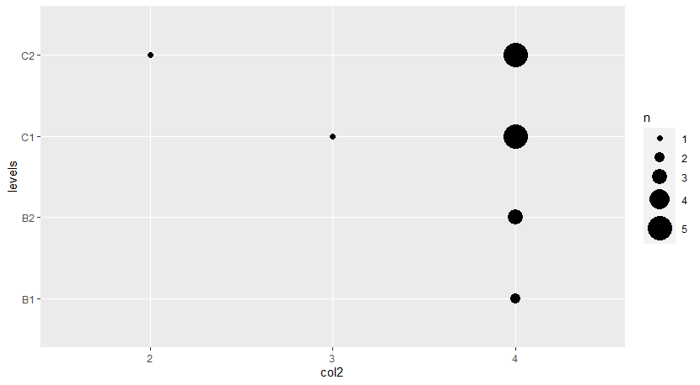

Slide 13
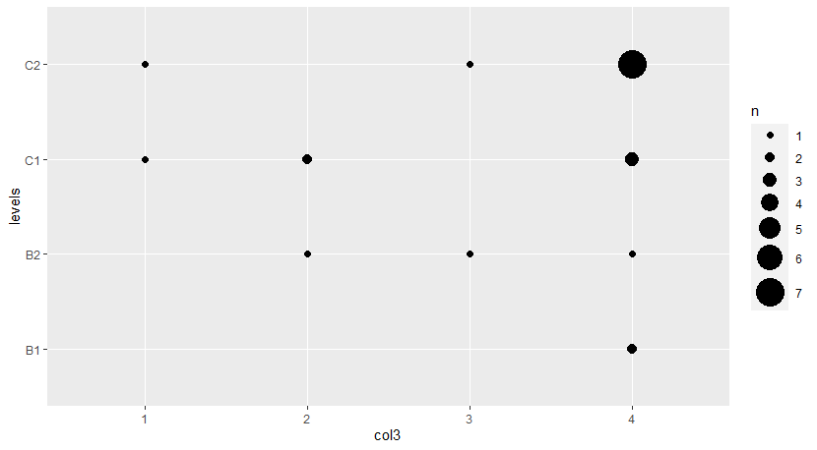
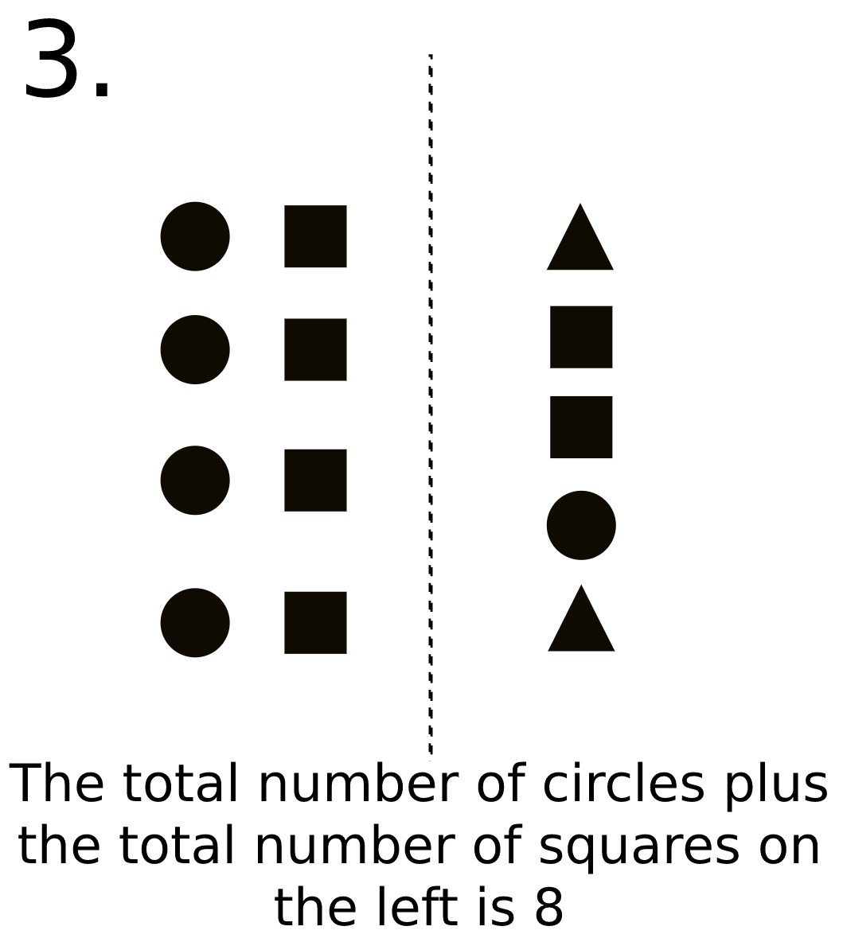
Question 2-3

Slide 14
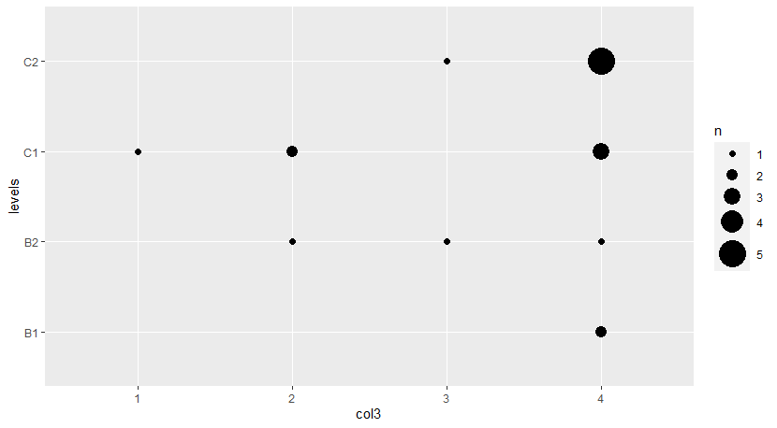

Slide 15
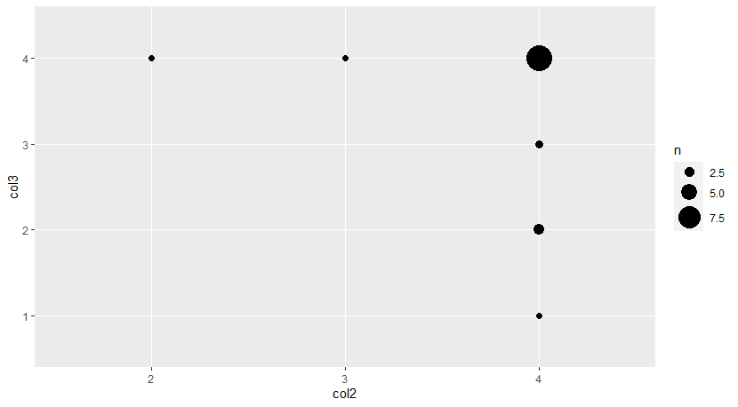
Comparison between 2 and 3:

Slide 16
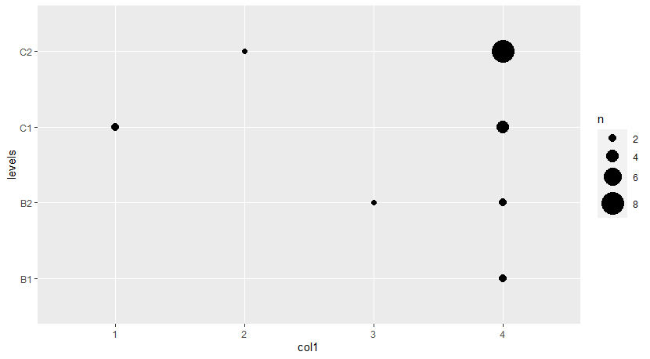
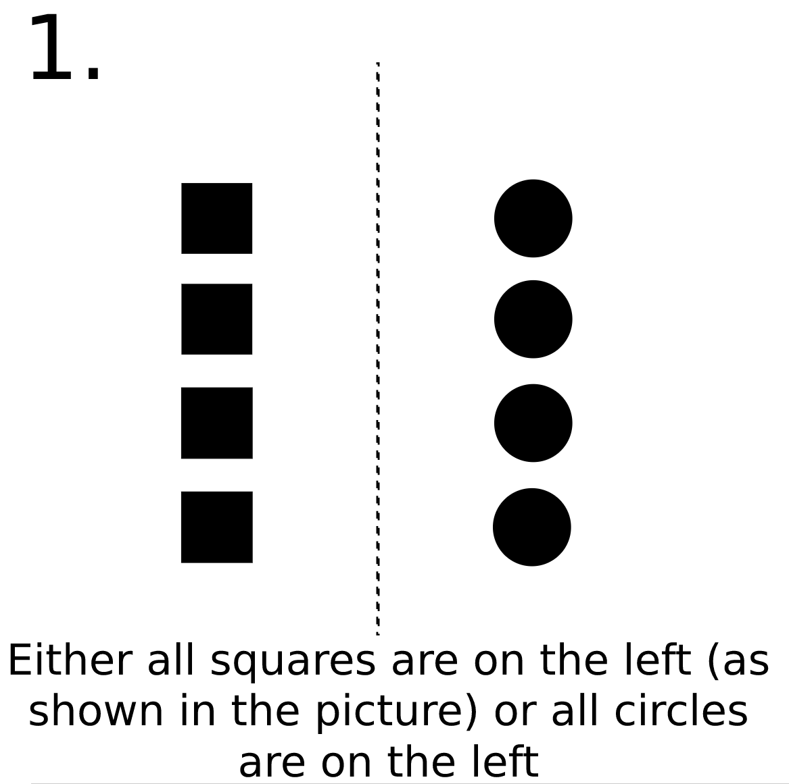
Question 3-1

Slide 17


Slide 18
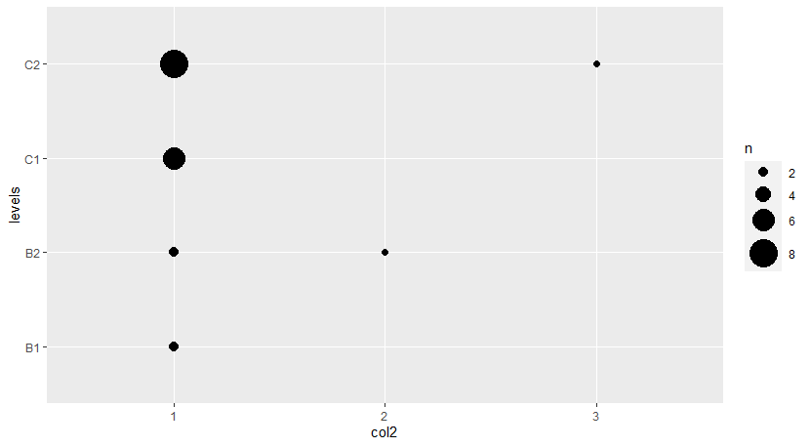
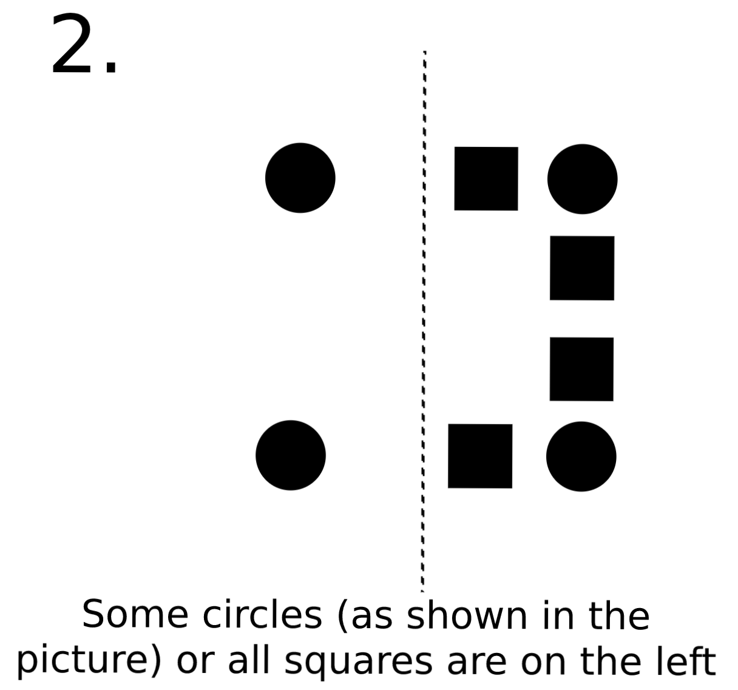
Question 3-2

Slide 19
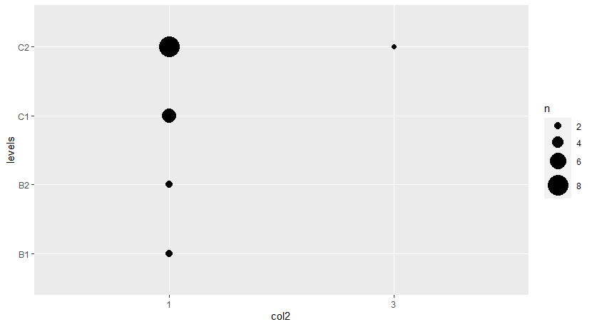

Slide 20
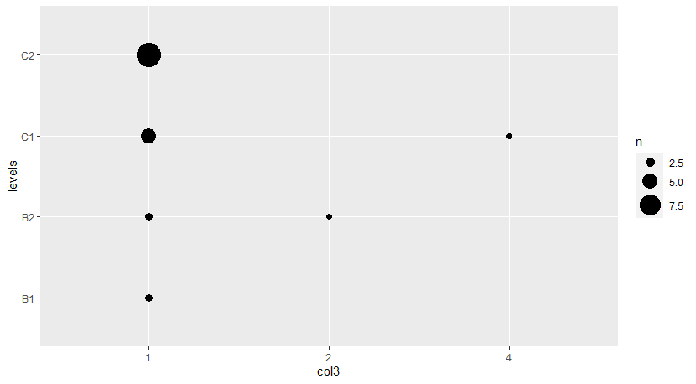
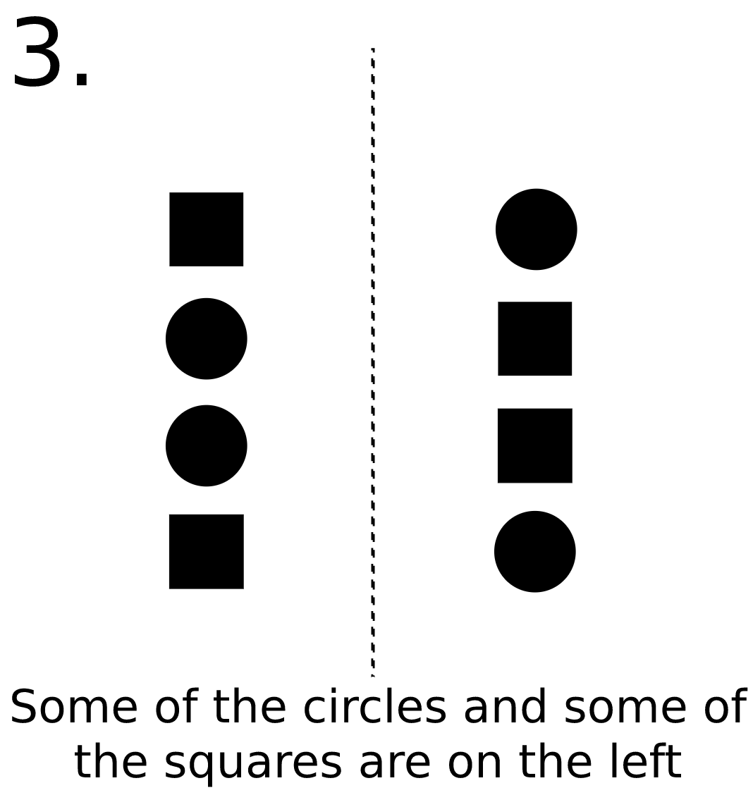
Question 3-3 (control)

Slide 21
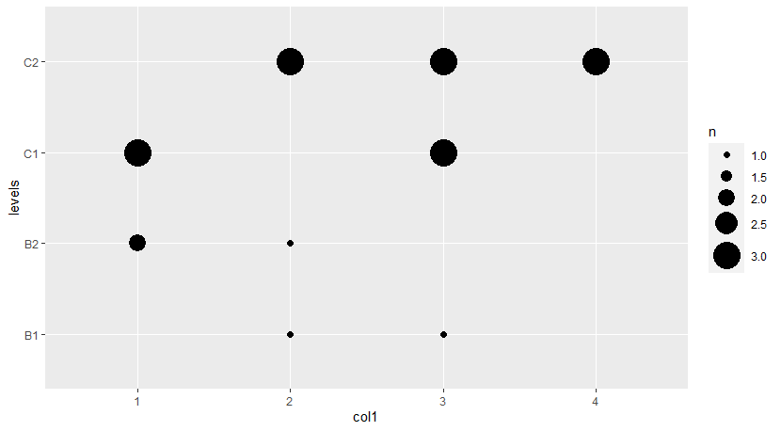
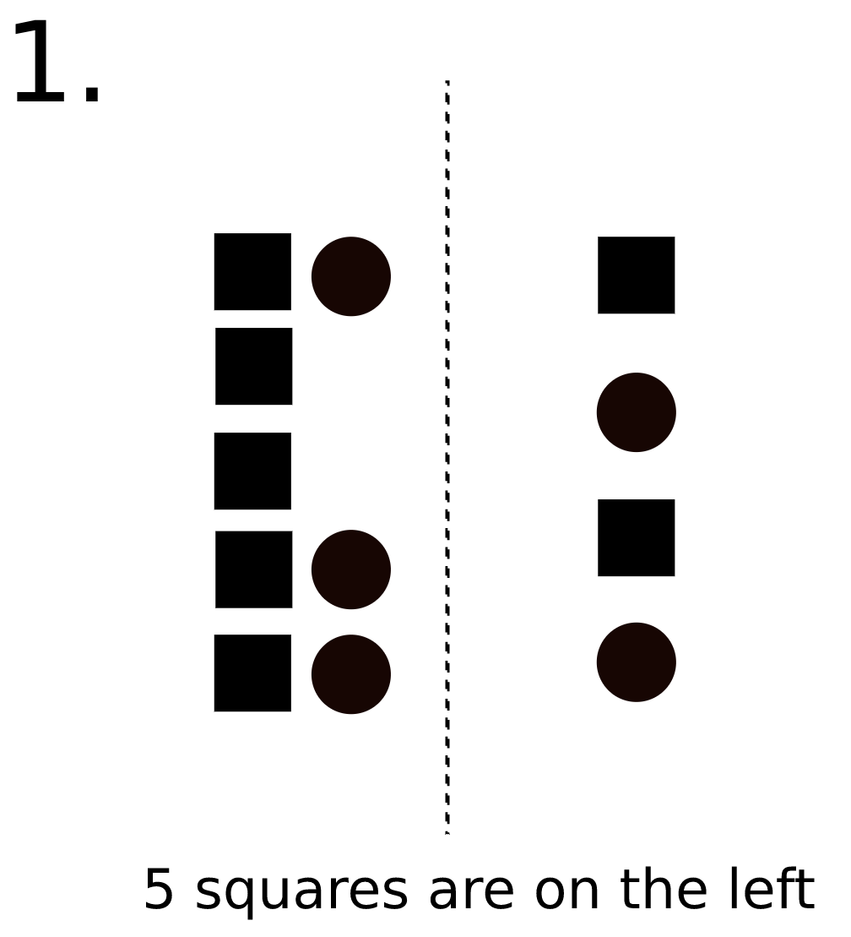
Question 4-1

Slide 22
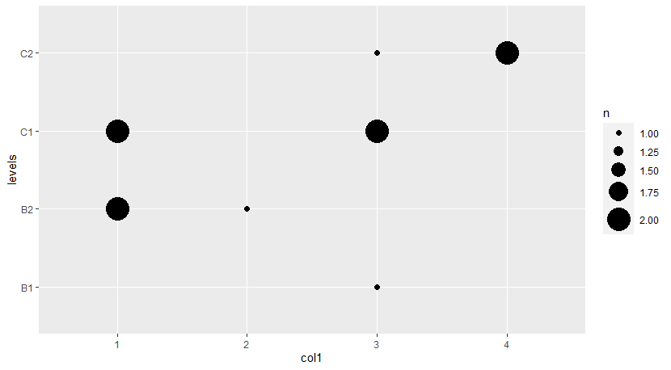

Slide 23
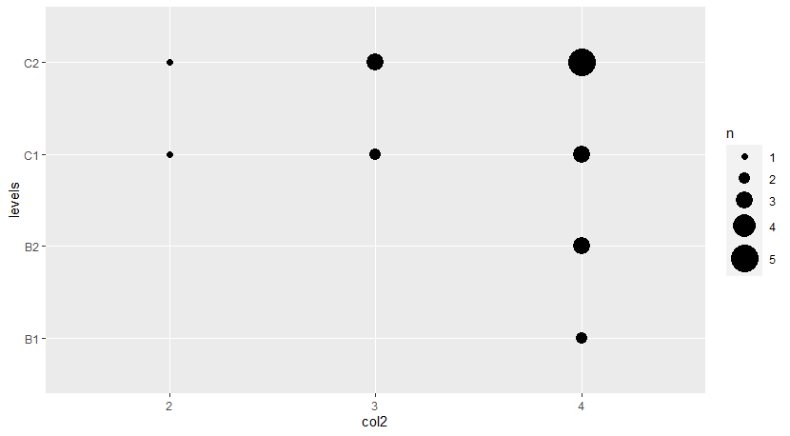
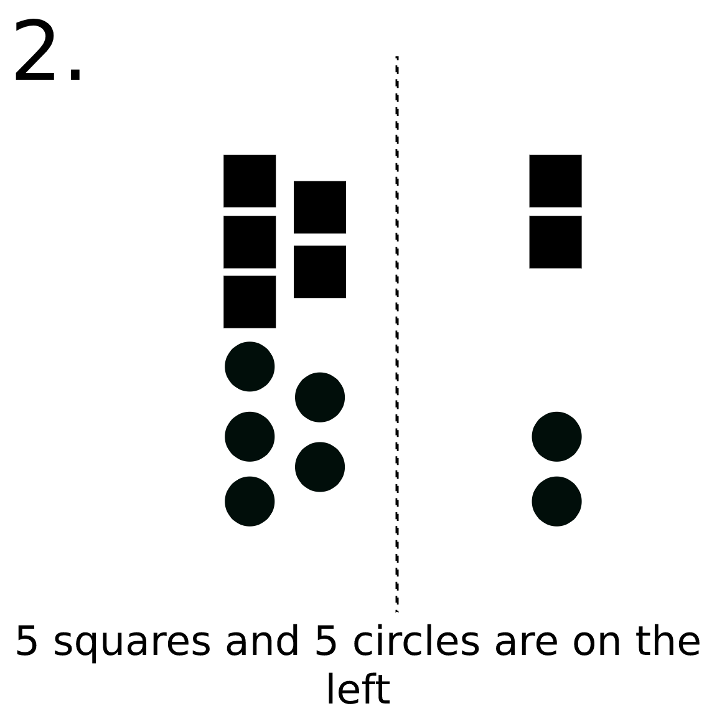
Question 4-2

Slide 24
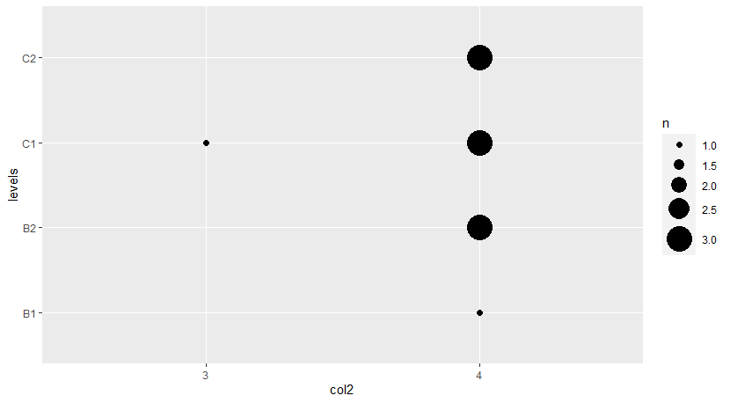

Slide 25
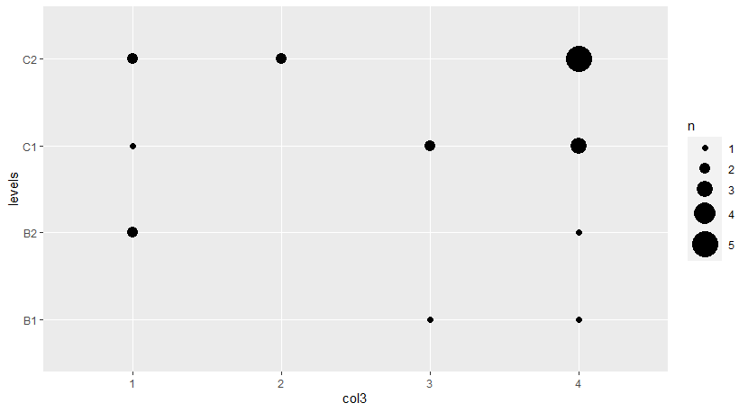
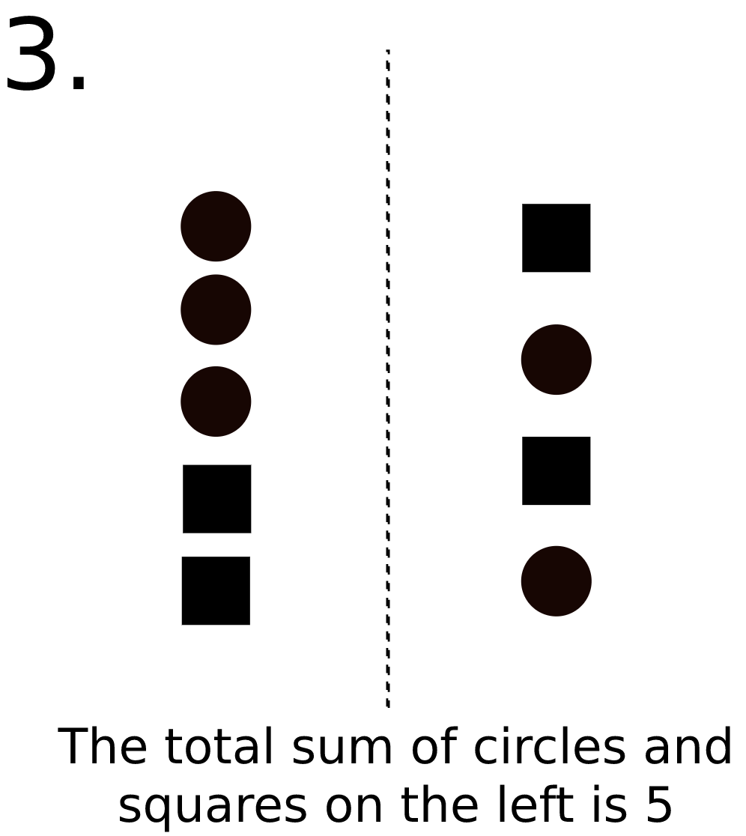
Question 4-3

Slide 26
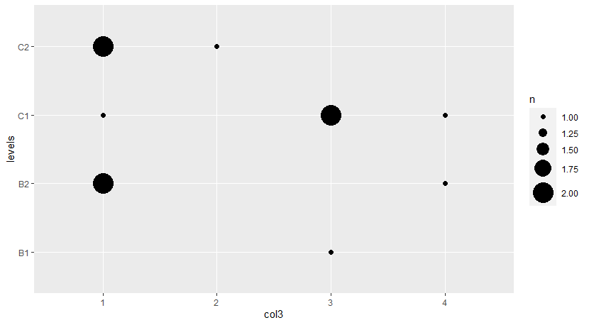

Slide 27
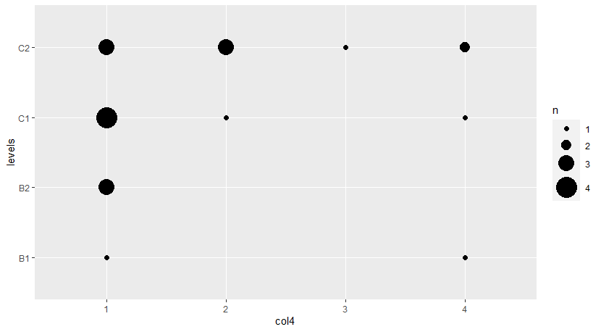
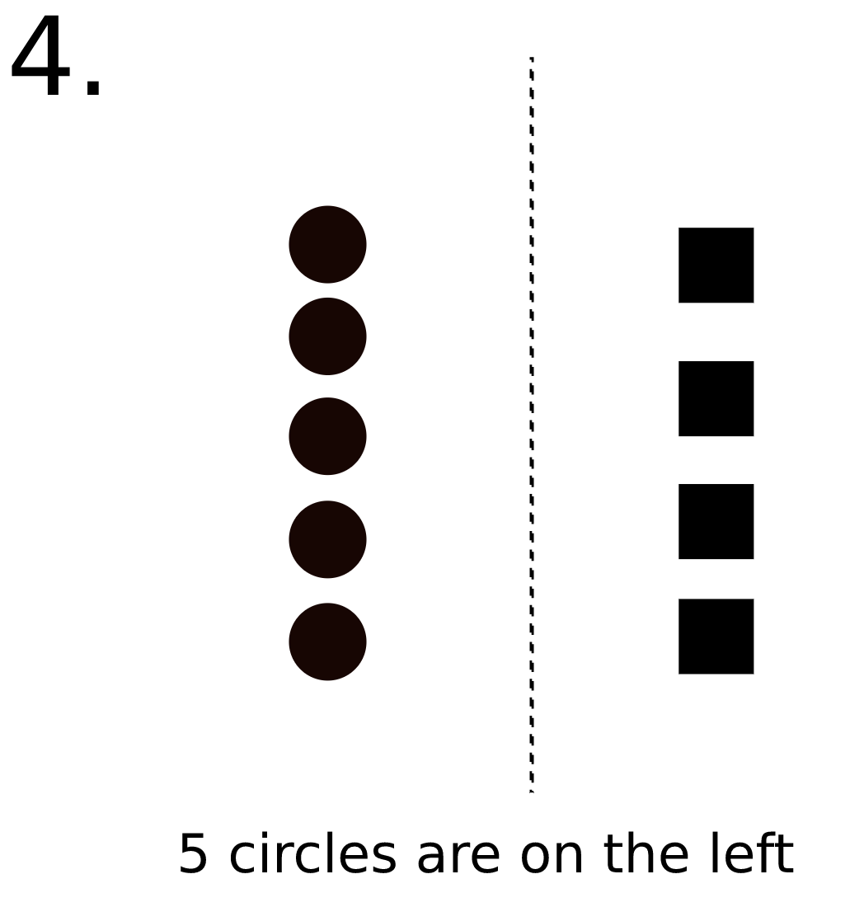
Question 4-4 (control)

Slide 28
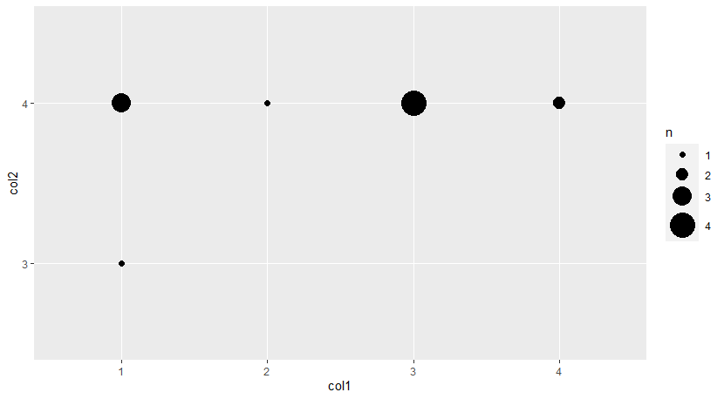
Comparison between 1 and 2:

Slide 29
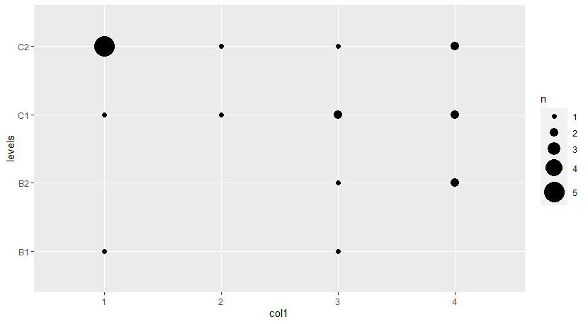
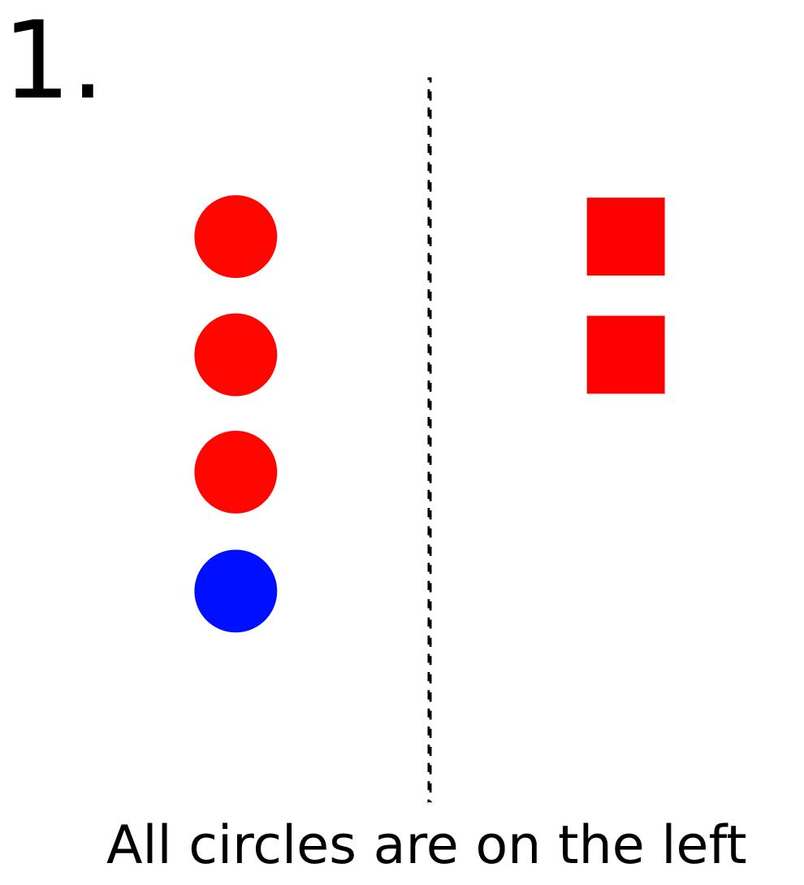
Question 5-1

Slide 30
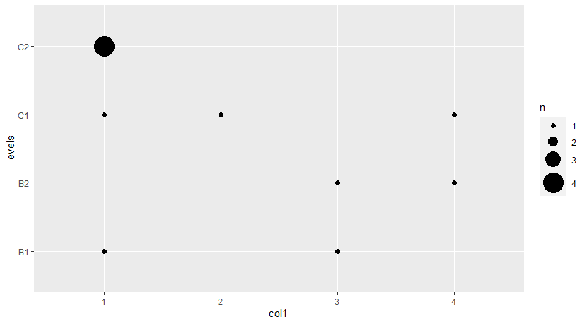

Slide 31
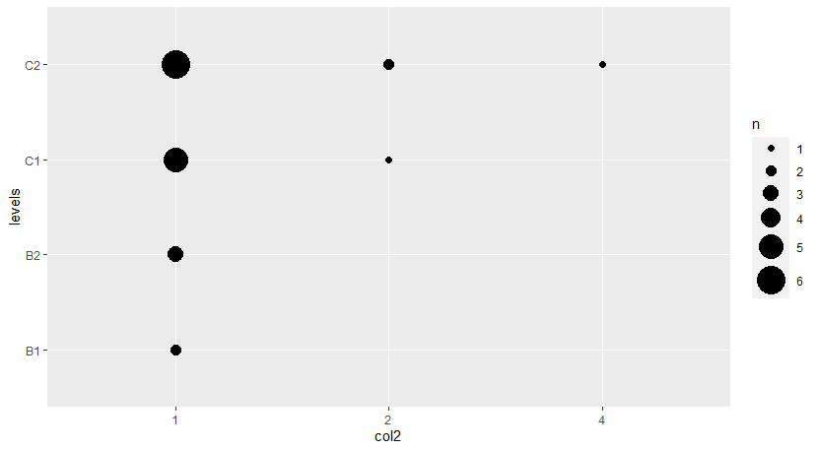
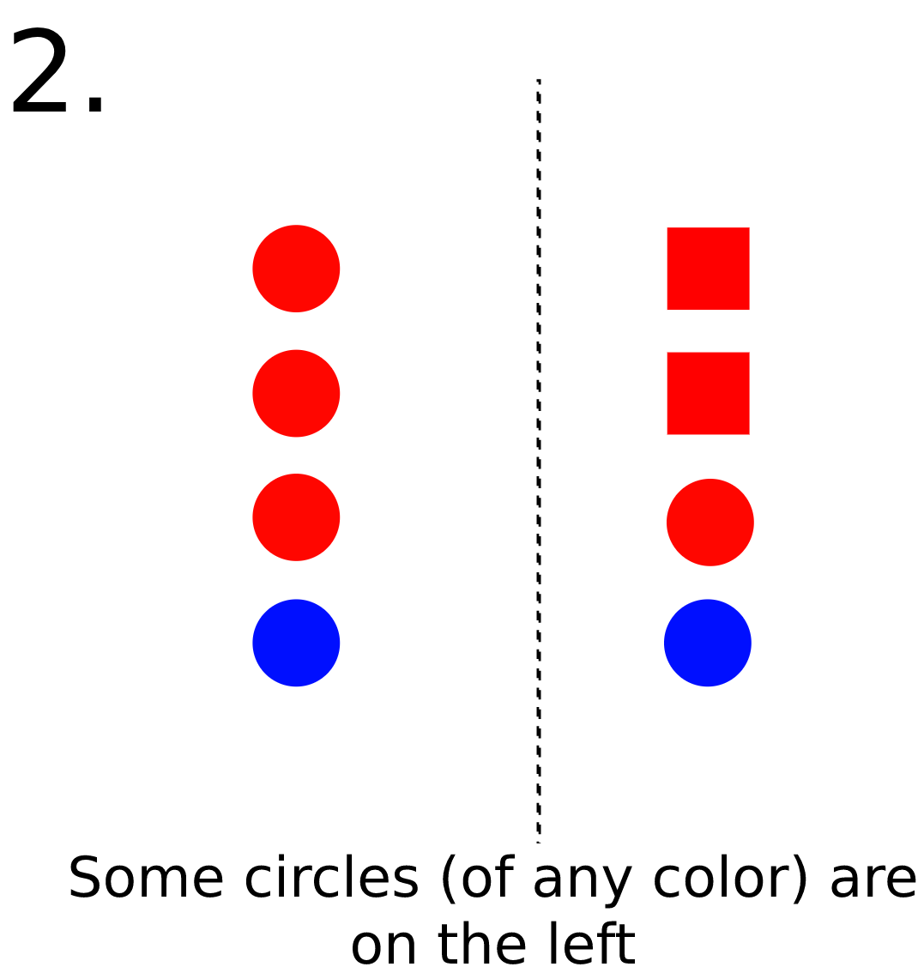
Question 5-2

Slide 32
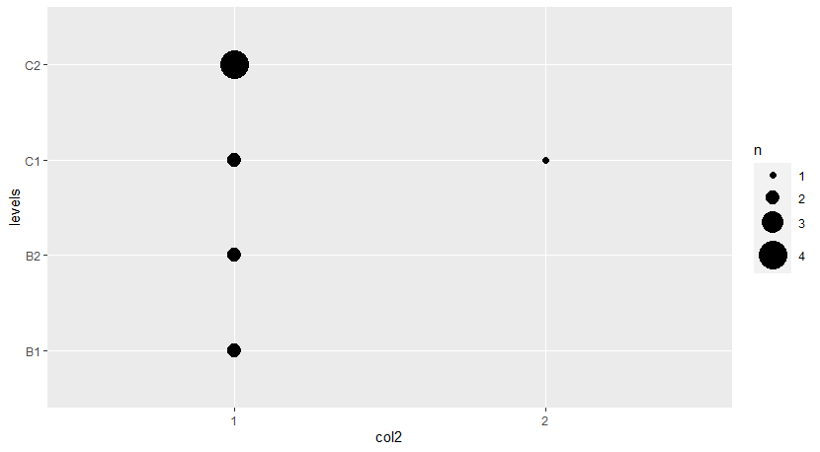

Slide 33
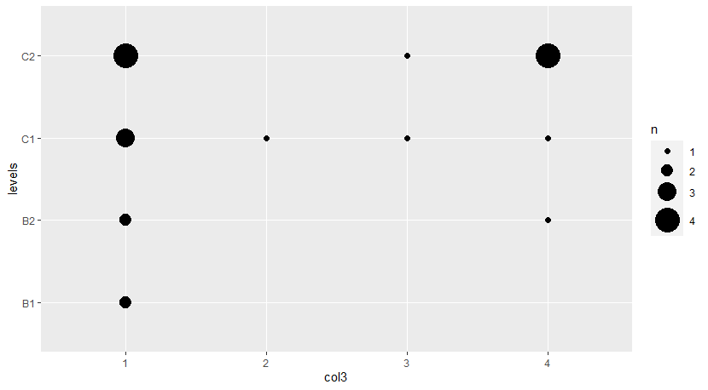
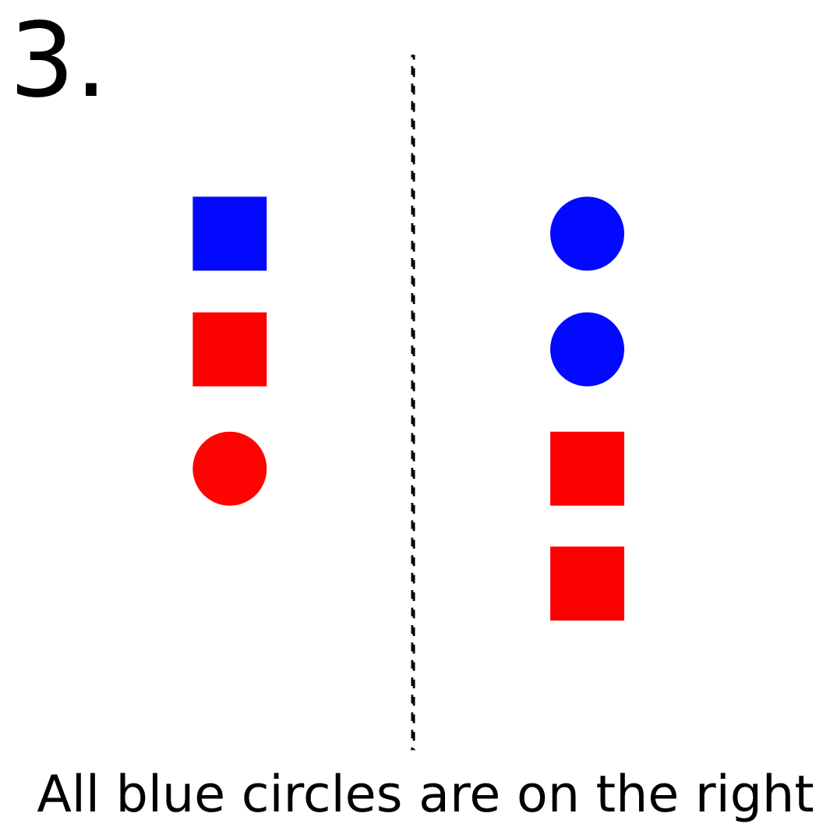
Question 5-3 (control)

Slide 34
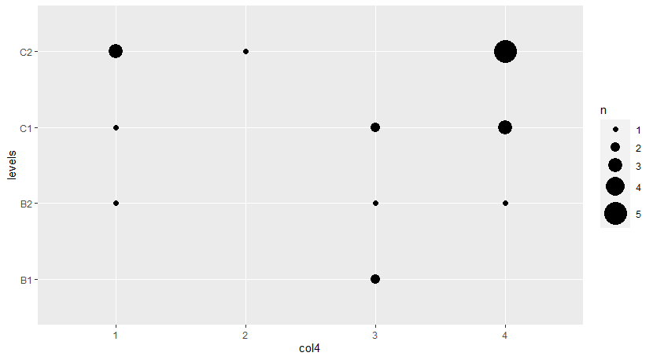
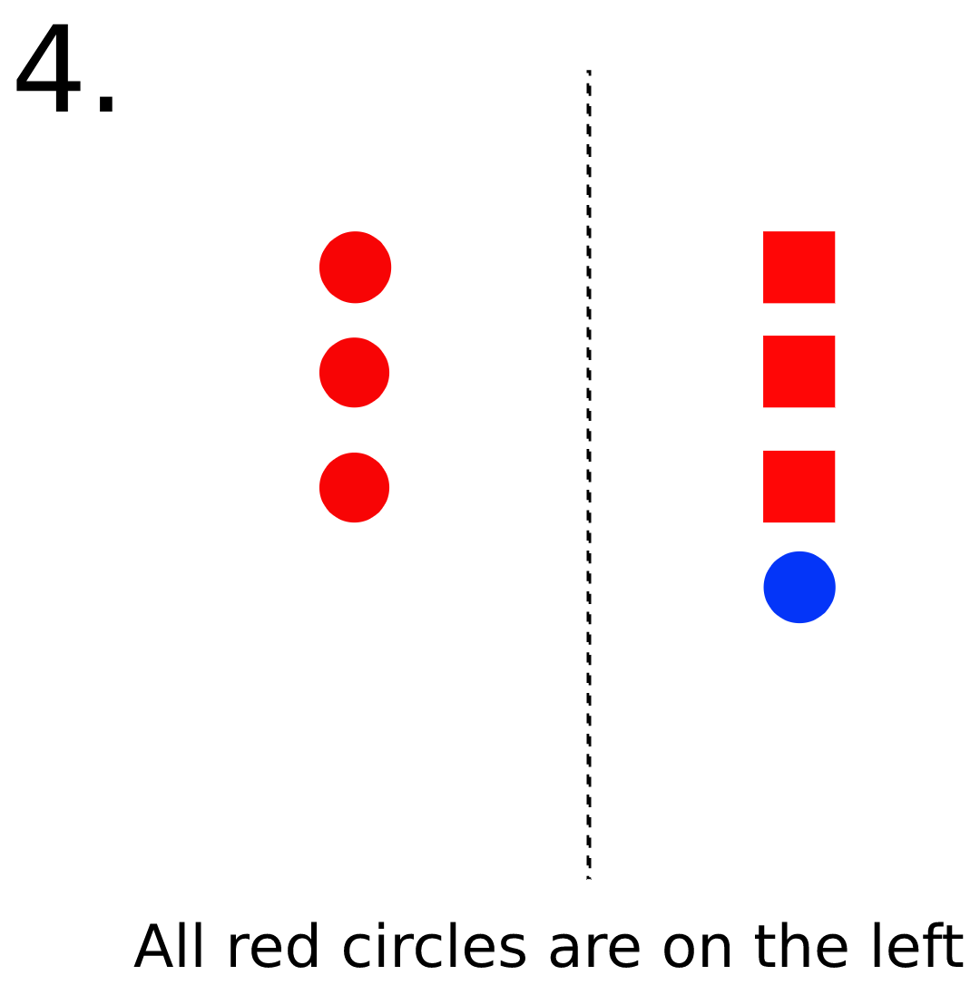
Question 5-4

Slide 35


Slide 36

Comparison between 1 and 4:

Slide 37


Question 6-1

Slide 38


Slide 39


Question 6-2

Slide 40


Slide 41


Question 6-3 (control)

Slide 42


Question 6-4

Slide 43


Slide 44

Comparison between 1 and 4:

Slide 45


Question 7-1

Slide 46


Slide 47


Question 7-2

Slide 48


Slide 49


Question 7-3 (control)

Slide 50


Question 8-1

Slide 51


Slide 52


Question 8-2

Slide 53


Slide 54


Question 8-3 (control)

Slide 55

Comparison between 1 and 2:

Slide 56


Question 9-1

Slide 57


Slide 58


Question 9-2 (control)

Slide 59

Question 9-3

Slide 60


Slide 61

Question 9-4

Slide 62


Slide 63

Comparison between 1 and 3:

Slide 64


Question 10-1

Slide 65


Slide 66


Question 10-2 (control)

Slide 67


Question 10-3

Slide 68


Slide 69

Question 11-1

Slide 70


Slide 71

Question 11-2

Slide 72


Slide 73

Question 11-3 (control)

Slide 74

Question 11-4

Slide 75


Slide 76

Comparison between 1 and 4:

Slide 77


Question 12-1

Slide 78


Slide 79


Question 12-2 (control)

Slide 80


Question 12-3

Slide 81


Slide 82


Question 12-4

Slide 83


Slide 84

Comparison between 1 and 4:

